Slide 1


Climate Modelling
Global Climate Change – Week 7
Dr Thomas Bannan
Thomas.Bannan@Manchester.ac.uk

Slide 2


Global Climate Change - 2026
Week 1 – Introduction to climate change and its impacts (5th Feb)
Week 2 – Natural climate variability (12th Feb)
Week 3 – Radiation Law/Greenhouse Effect/Radiative forcing/feedbacks (19th Feb)
Week 4 – Anthropogenic impacts (26th Feb)
Week 5 – The Evidence Base for Climate Change (5th March)
Week 6 – Mid Unit Test (10th March)
Week 7 – Climate Models (19th March)
Week 8 – Climate Change Adaptation (26th March)
Week 9 – Effects of Climate Change: Case Studies (23rd April)
Week 10 – Climate Change Mitigation (30th April)
Week 11 – Revision Lecture (7th May)
Comments/Questions

Slide 3

Today’s session
  Part 1: Key points on climate change modelling (45 mins)
  Part 2: Q/A and Break (10 mins)
  Part 3: Workshop on climate modelling (50 mins)

Slide 4
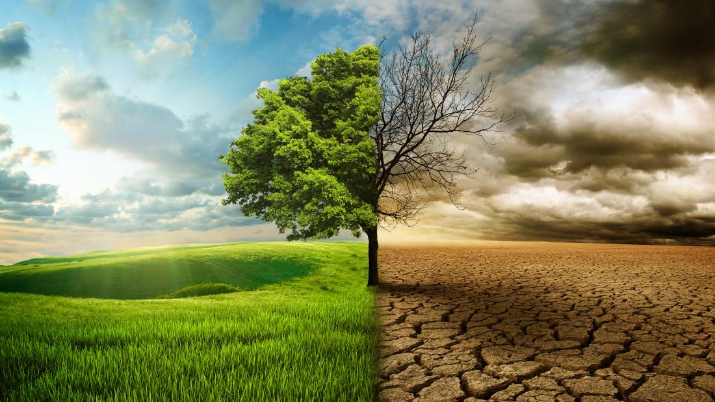
Intended Learning Outcomes
By the end of the week you will be able to:
Understand the Role of Climate Models and explain why climate models are used to study and predict climate change.
Identify the main components of global climate models and how they interact.
Discuss uncertainties in climate models and how hindcasting is used to test their reliability.
Differentiate between natural climate variability and antheropogenic climate change.
Explain how Representative Concentration Pathways (RCPs) inform future climate projections
Understand how climate models will change into the future

Slide 5
“How do we know climate change is real — and how do we know it’s us?”
Is it changing? Observations
Is it unusual? Context from paleoclimate (week 1 and 2)
Is it us? physics (week 3) + models (week 7) + measurements (week 5) = attribution

Slide 6
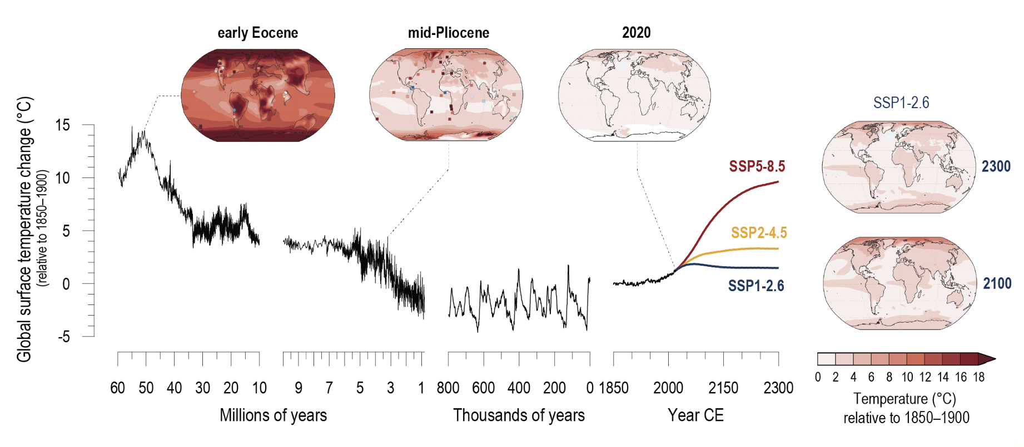
Measurements: last 6 million years
Global Climate Models

Slide 7

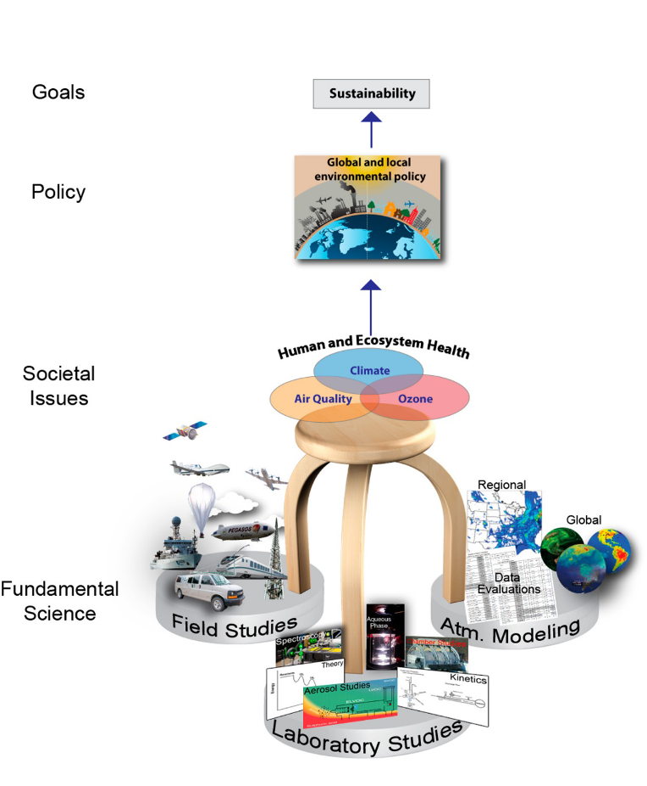

Our key question today: How do we predict future climate change?

Slide 8
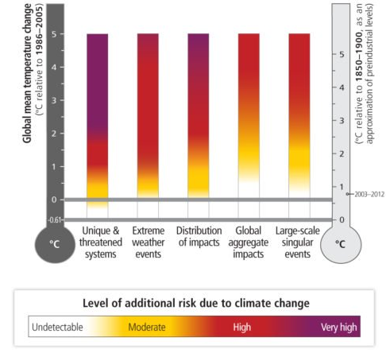
Our key question today: How do we predict the impact of climate change?

Slide 9
Global Climate Models
We have covered the main concepts that feed into computer models to simulate and predict climate change. We now look at how these models work and their results.
The concept of radiative forcing is central to climate models.
Climate models project climate (the average weather over a long period of time, e.g., a 30-year period), not weather (what an area experiences on an hourly or daily basis).
Models help us understand how our actions can affect the future climate.
They allow modelers to look at different scenarios of increased greenhouse gas emissions and see how increases may affect us

Slide 10
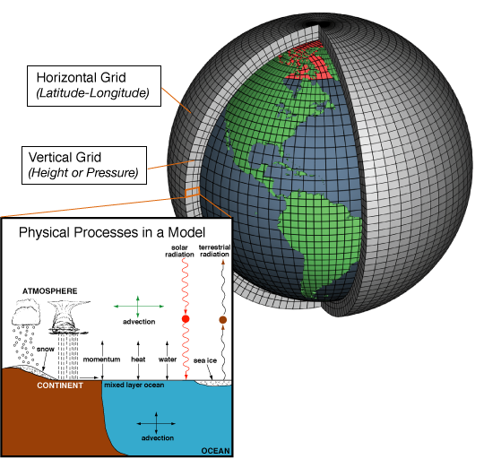
Global Climate Models
Representation of a GCM with energy exchange, precipitation and other processes.
Climate models calculate the physical interactions between four components:
Atmosphere
Land
Ocean
Sea ice
The calculations are based on several inputs:
Air temperature
Pressure
Density
Water vapor content
Wind magnitude and many more…..

Slide 11
Global Climate Models
The size and complexity of the Earth makes this challenging
Different places have different responses to energy (e.g., land warms up and cools down faster than oceans).
We divide Earth into a 3D grid across the surface, up into the atmosphere, and down into the ocean.
Each cube is analysed individually over time while receiving information (inputs) from and passing information (outputs) to neighbouring cubes.
The size of the cubes varies among models
A higher resolution model has more, smaller cubes and provides a more accurate picture of how changes to the climate impact an area.

Slide 12
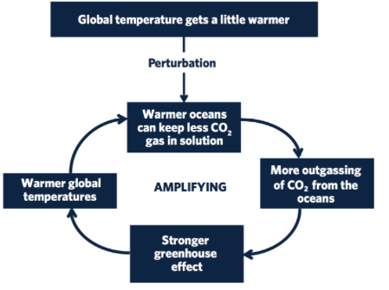
History of Climate Models – 90s – 00s
Atmosphere only Model
Earlier models calculated physical processes for the atmosphere, land, ocean, and sea ice components separately.
Initially GCMs treated atmosphere and ocean models as separate entities.
Atmosphere models focused on simulating atmospheric dynamics, while ocean models represented oceanic circulation and thermodynamics.
These separate models were run independently and their outputs were not directly interconnected.
Ocean only Model
Why is this a problem?

Slide 13
History of Climate Models – 90s – 00s
Atmosphere only Model
Earlier models calculated physical processes for the atmosphere, land, ocean, and sea ice components separately.
Initially GCMs treated atmosphere and ocean models as separate entities.
Atmosphere models focused on simulating atmospheric dynamics, while ocean models represented oceanic circulation and thermodynamics.
These separate models were run independently and their outputs were not directly interconnected.
Coupling atmosphere and ocean models allowed for the interaction to be simulated.
These now allow feedback loops between the atmosphere and ocean, such as the influence of ocean currents on atmospheric circulation patterns and vice versa.
Thus capturing complex interactions and feedback mechanisms.
Can capture phenomena such as El Niño-Southern Oscillation (ENSO) which are crucial for understanding global climate variability.
GCMs can now produce more realistic climate projections on both regional and global scales.
Ocean only Model
Atmosphere Model
Ocean Model

Slide 14
History of Climate Models 2010s +
Biosphere Model Integration:
  Terrestrial vegetation, ecosystems, and biogeochemical cycles.
  Simulates processes like photosynthesis, respiration, and carbon cycling,
  Enables assessment of land use changes, deforestation, and vegetation
Chemistry Model:
  Simulate interactions of atmospheric gases and aerosols, including pollutants and greenhouse gases.
  Predicts atmospheric composition changes like ozone depletion, aerosol formation, and air quality
  Enhances understanding of atmospheric processes, their climate impacts, and the effectiveness of mitigation strategies targeting pollutant emissions.
Cryosphere Model Incorporation:
  Cryosphere models represent ice sheets, glaciers, snow cover, and permafrost dynamics within GCMs.
  Captures feedback mechanisms like ice-albedo, sea level, and climate
  Improves prediction of ice mass balance, sea ice extent
Coupled GCMs with biogeochemical cycles
Atmospheric Model
Chemistry Model
Cryosphere Model
Coupler
Biosphere Model
Ocean Model

Slide 15
History of Climate Models 2010s +
Coupled GCMs with biogeochemical cycles
Benefits of coupling:
Comprehensive representation of Earth's interconnected systems.
Facilitates a deeper understanding of climate change impacts.
Informs decision-making for adaptation and mitigation efforts.
Enables more accurate climate projections, aiding in policy formulation and resource allocation.
Atmospheric Model
Chemistry Model
Cryosphere Model
Coupler
Biosphere Model
Ocean Model

Slide 16
Discussion
If you were building a climate model, what variables would you absolutely need to include?
If you wanted to test whether a climate model works, how would you do it?

Slide 17
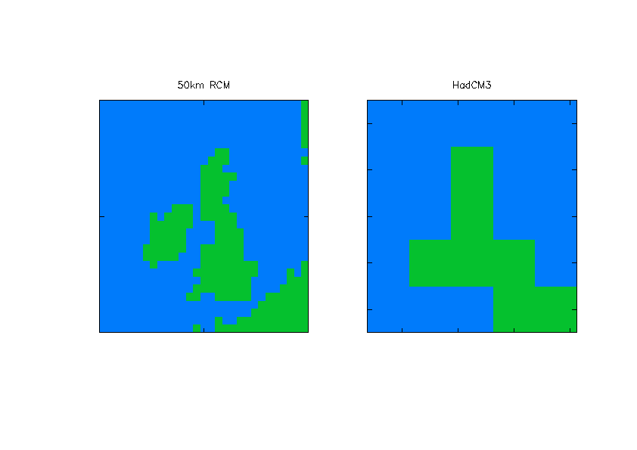
Resolution of Global Climate Models
1998: GLOBAL MODEL
2002: REGIONAL MODEL
Initially, GCMs had resolutions of 250 to 600 km horizontally, with limited vertical layers.
Improved computing power allowed for higher resolutions, enabling better representation of small-scale processes.
Higher resolutions are crucial for capturing regional climate variations accurately.
Challenges remain, such as parameterizing small-scale processes like clouds, leading to uncertainties in future climate projections.
GCMs play a vital role in understanding and predicting the Earth's climate response to increasing greenhouse gas concentrations.
This also requires a huge amount of computational power, not possible on personal computers
300km grid
50km grid
Hadley Centre
Hadley Centre

Slide 18
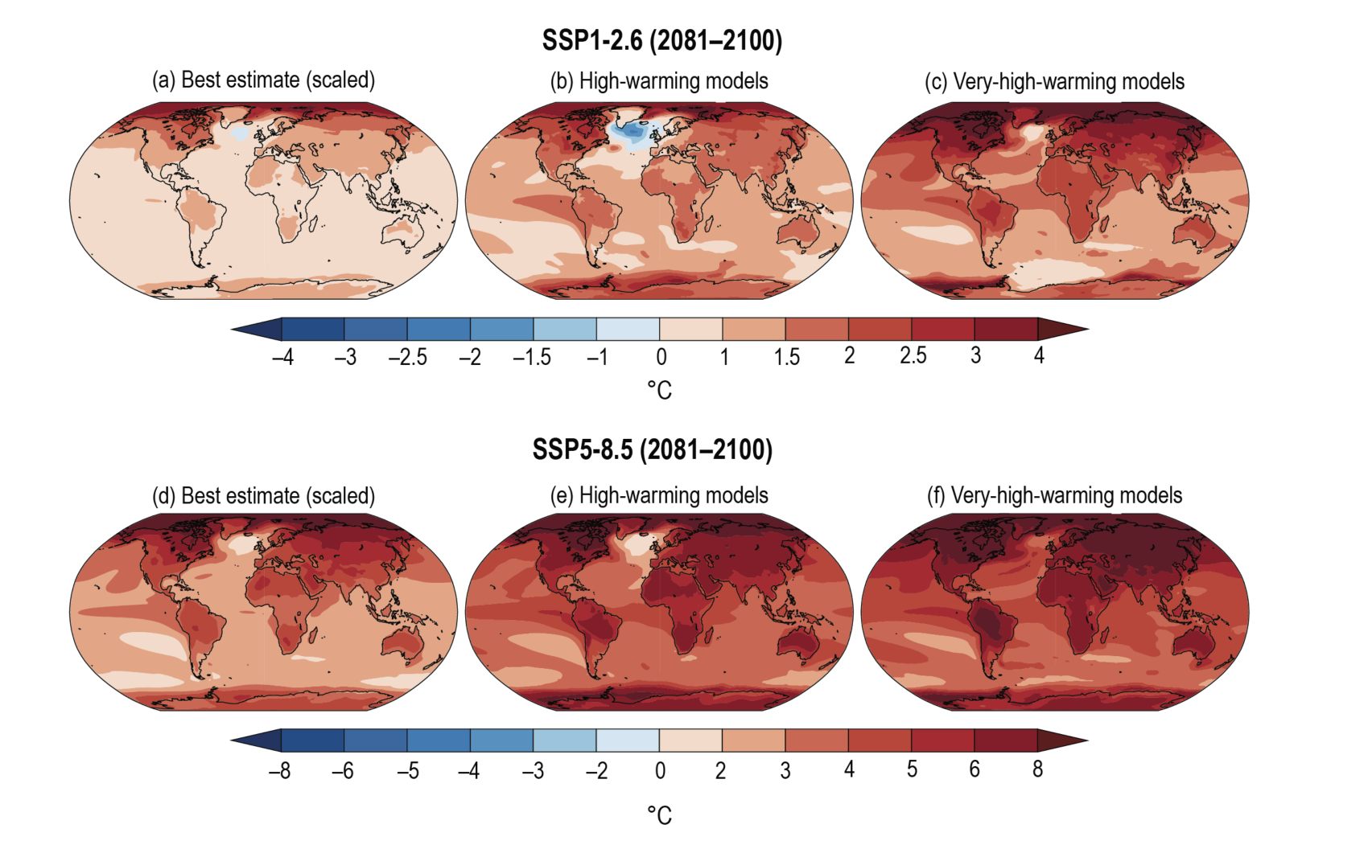

Temperature Measurements: Future

Slide 19
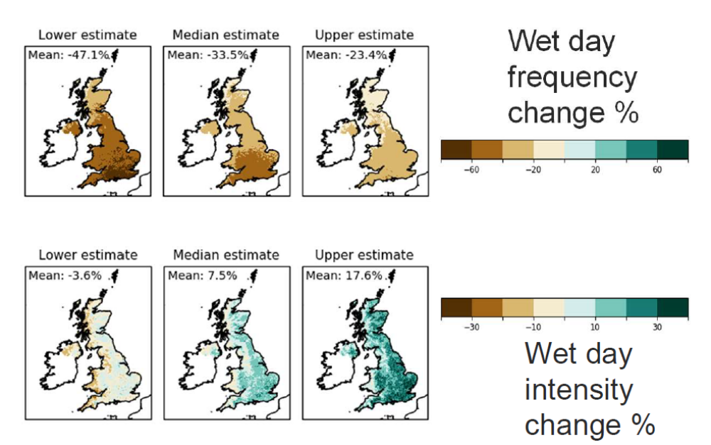
Resolution of Global Climate Models
UK ‘local’ climate projections: summer rainfall
Summer rainfall is less frequent but more intense

Slide 20
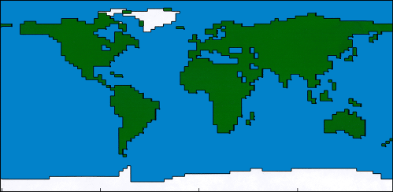
The Hadley Centre – Third Coupled Model
19 levels in
atmosphere
30km
The Hadley Centre Third Coupled Model (HadCM3) was developed by the UK Met Office's Hadley Centre for Climate Prediction and Research.
HadCM3 was a pioneering global climate model that integrated atmosphere, ocean, sea ice, and land surface components.
It played a significant role in climate research and was widely used in studies assessing the impacts of greenhouse gas emissions and anthropogenic activities on global climate.
HadCM3 contributed to the Intergovernmental Panel on Climate Change (IPCC) assessments, providing valuable insights into future climate scenarios and informing international climate policy discussions.
2.5
lat
3.75
long
1.25
1.25
20 levels
in ocean
Hadley Centre
-5km

Slide 21
GCM: Atmospheric Composition
Sources
Sinks
Chemical
production
Chemical
loss
Atmospheric “box”;
spatial distribution of X within box is not resolved
box can be global atmosphere or some subdomain
P
L
Inflow
Outflow
F_{in}
X
F_{out}
E
D
Emission
Deposition
Let m [kg] be the mass of X in the box

Slide 22
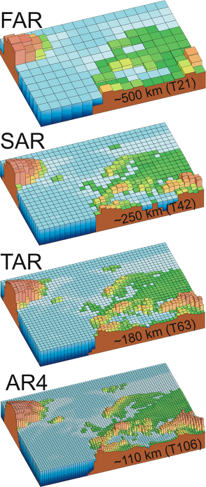
Intergovernmental Panel on Climate Change
The First Assessment Report (FAR) was published by the IPCC in 1990.
It represented the first comprehensive assessment of climate change science, impacts, and potential mitigation strategies.
FAR played a crucial role in raising global awareness about the issue of climate change.
The Second Assessment Report (SAR) was released in 1995.
It provided an updated and more detailed understanding of climate change science
The SAR also highlighted emerging issues such as the potential impacts of climate change on vulnerable regions.
important material for governments to draw from in the run-up to adoption of the Kyoto Protocol in 1997
The Third Assessment Report (TAR) was published in 2001
assessments of observed changes in climate, projections of future climate scenarios, and the potential impacts of climate change on various sectors such as agriculture, water resources, and human health.
The TAR contributed significantly to international climate negotiations and policy discussions.
The Fourth Assessment Report (AR4) was released in 2007.
Provided an updated assessment of climate change science, impacts, adaptation, and mitigation strategies.
The AR4 incorporated advancements in climate modeling, observational data, and understanding of climate feedback mechanisms.
laid the ground-work for a post-Kyoto agreement, focusing on limiting warming to 2°C

Slide 23
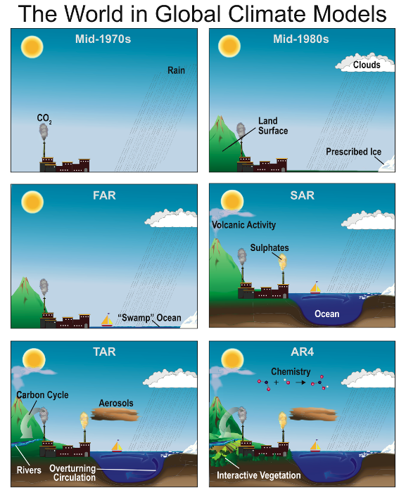
Performance of Global Climate Models
Modern Coupled GCMs
   Perform well at continental scales
   Perform well at multiannual -> climatological scales (30 year)
   Perform less well at short time scales
   Perform less well at regional scales
The complexity of climate models has increased over the last few decades. The additional physics incorporated in the models are shown pictorially by the different features of the modelled world.

Slide 24
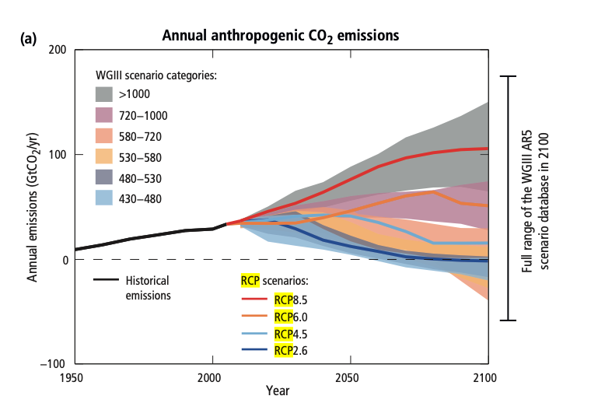
Representative Concentration Pathways (RCPs)
Anthropogenic GHG emissions are mainly driven by population size, economic activity, lifestyle, energy use, land use patterns, technology and climate policy.
The Representative Concentration Pathways (RCPs), which are used for making projections based on these factors, describe four different 21st century pathways of GHG emissions and atmospheric concentrations, air pollutant emissions and land use.
The RCPs include a stringent mitigation scenario (RCP2.6), two intermediate scenarios (RCP4.5 and RCP6.0) and one scenario with very high GHG emissions (RCP8.5). Scenarios without additional efforts to constrain emissions (’baseline scenarios’) lead to pathways ranging between RCP6.0 and RCP8.5.
RCP2.6 is representative of a scenario that aims to keep global warming likely below 2°C above pre-industrial temperatures. The RCPs are consistent with the wide range of scenarios in the literature as assessed by WGIII5.

Slide 25
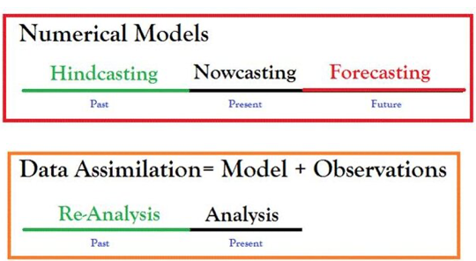
Where do some of the errors arise
Grid size
Atmospheric levels
Regional response
Natural variability
Cloud representation
Rainfall parameterisation
Climate models are evaluated for accuracy by “hindcasting,” or replicating the climate of the past 100 years.
Because models have been run since the 1990s, scientists can now see how accurate earlier models were at projecting future changes.

Slide 26
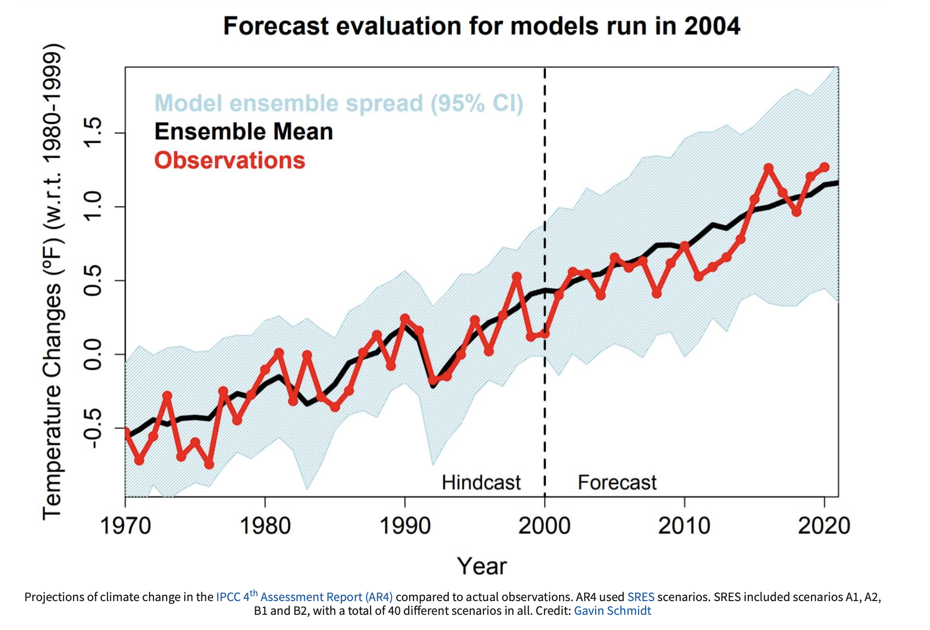
How did we do in 2004?
Observed changes in temperature and precipitation have generally been consistent with the changes projected by earlier models.
The accurate projections of future climate and hindcasting of past climate makes us confident that models can reliably project changes in the climate.

Slide 27
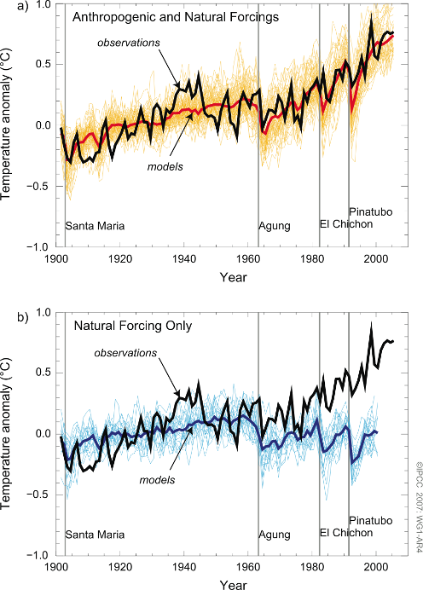
Modelling Anthropogenic Impacts
How would such a model simulation be carried out? The following protocol is typical.
1. A GCM model is run for many decades with no external forcing
2. The statistics of the run (mean climate, annual cycles and variability on a range of time scales) are then compared with observation to assess performance.
3. The model is then re-run with changes in forcing (such as greenhouse radiative forcing).
4. The difference in the two climates provides an estimate of the consequent climate change arising form that forcing factor.

Slide 28
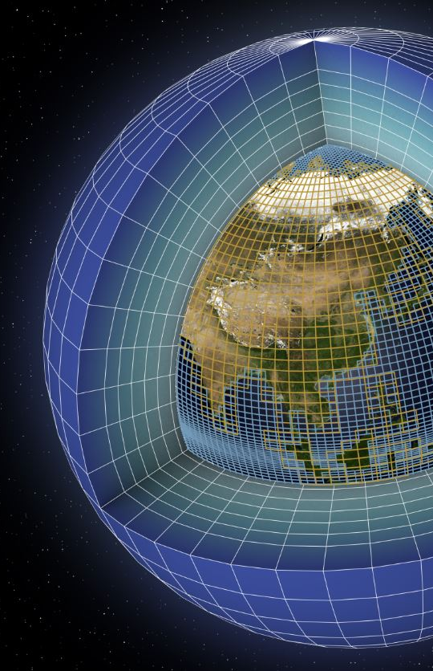
Factors to consider….
Short term changes are not reproduced but the results look encouraging.
However, problems remain –
Is the temperature record reliable?
Cause and effect not finally established
Large uncertainties in radiative forcing and the effect of aerosols
Discrepancies remain between predicted and observed regional pattern of change
Not all factors are represented in GCMs – e.g. nitrogen cycle
As complexity is increased so is computing power

Slide 29
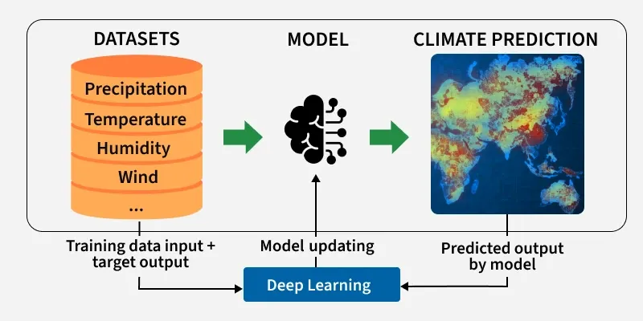
GCMs into the Future
Current GCMs rely heavily on physical equations and parameterisations.
Struggle with small-scale processes and nonlinear climate behavior.
Require very high computational resources.
Artificial Intelligence (AI) and Machine Learning (ML) are possible solutions
Used to analyse large and complex climate datasets.
Improves prediction accuracy in weather and climate systems.
Helps accelerate climate research and simulations.

Slide 30
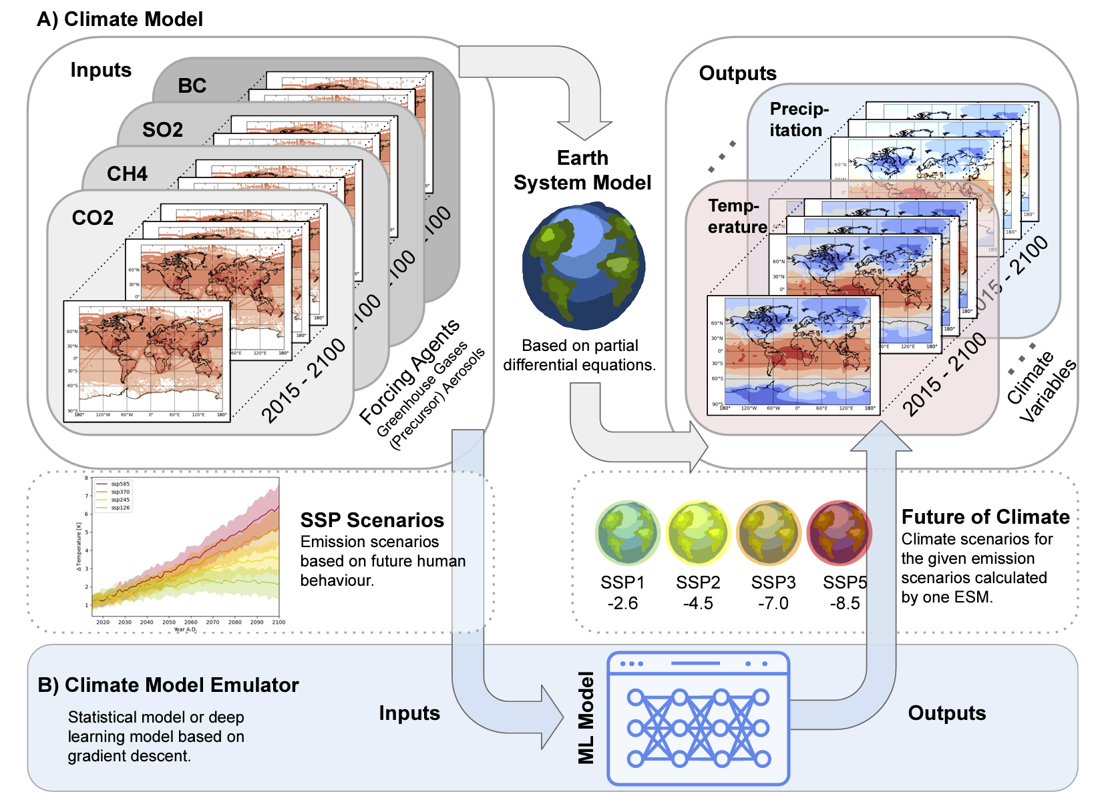
GCMs into the Future
Advantages: handles nonlinear relationships and large datasets.
Faster simulations and improved extreme event prediction.
Challenges: model interpretability and data bias.
Ensuring physical consistency with climate laws.

Slide 31
In summary, GCMs provide….
Climate models offer predictions about future climate conditions on a global scale, informing us about changes driven by increased greenhouse gas emissions.
They provide valuable insights into how human activities could impact global temperatures, humidity, and precipitation patterns.
Climate models project varying degrees of temperature rise across different regions of the world, alongside shifts in precipitation patterns and snowfall events.
These models are instrumental in understanding potential impacts on natural resources, ecosystems, agriculture, water resources, and coastal areas globally.
They serve as tools for policymakers, scientists, and stakeholders to plan for the complex challenges posed by climate change

Slide 32
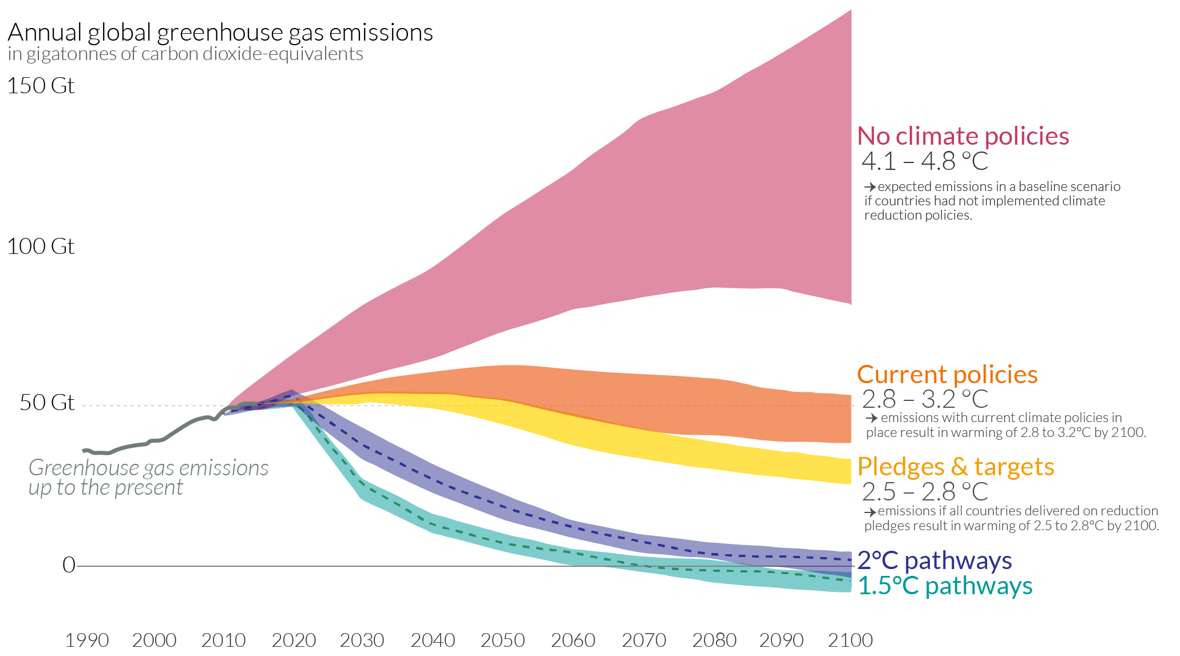
Future projections

Slide 33
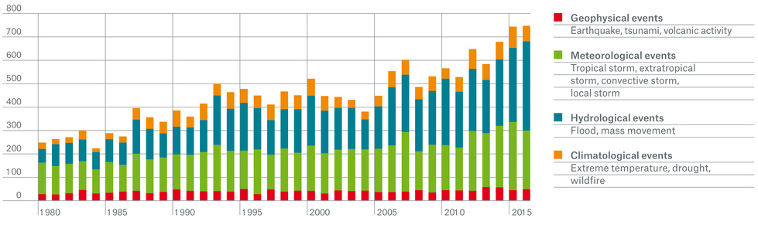
Impacts: Increase in Natural Disasters
Global warming has been linked to an increase in the frequency, intensity, and severity of various types of natural disasters.
Heatwaves: Rising temperatures have led to more frequent and intense heatwaves. Heatwaves can have serious health implications, leading to heat-related illnesses and deaths, particularly among vulnerable populations.
Extreme Weather Events: GW can contribute to the intensification of extreme weather events such as hurricanes, typhoons, and cyclones. Warmer ocean temperatures provide more energy to fuel these storms, leading to increased wind speeds and heavier rainfall
Flooding: Higher temperatures accelerate the melting of glaciers and ice caps, leading to rising sea levels. This, coupled with increased precipitation intensity, can result in more frequent and severe flooding events
Droughts: Changes in precipitation patterns and increased evaporation rates due to higher temperatures can contribute to more frequent and prolonged droughts. Droughts can have significant impacts on agriculture, water resources, and ecosystems and loss of biodiversity.
Wildfires: Warmer temperatures, coupled with changes in precipitation patterns, can create conditions conducive to the spread of wildfires. Drier vegetation and increased fire risk can lead to larger and more frequent wildfires, posing threats to human health, property, and ecosystems.
WEEK 8

Slide 34
What could limit global warming to 1.5ºC?
To strengthen the global response, almost all countries would need to significantly raise their level of ambition
Solar, wind, and electricity storage technologies more feasible
Nuclear energy and carbon capture technology improvements lacking
Electrification, hydrogen, bio-based feedstocks crucial for emissions reduction
Land use transitions necessary for limiting warming to 1.5°C
Efficiency in food production can reduce emissions and enhance food security
Dietary shifts and reduced food waste can lower emissions and increase adaptation
Participatory and integrated mitigation and adaptation approaches enable rapid transitions for limiting warming
WEEK 9

Slide 35
Lecture Summary
Global Climate Models (GCMs) simulate the Earth’s climate by representing interactions between the atmosphere, oceans, land, and sea ice to understand long-term climate behaviour.
The Earth is divided into a 3-D grid, where variables such as temperature, pressure, wind, and water vapour are calculated and exchanged between grid cells. Higher resolution improves accuracy but requires computational power.
Modern models are coupled Earth system models, linking atmosphere, ocean, cryosphere, biosphere, and atmospheric chemistry to capture important climate feedbacks.
Models are tested using hindcasting, where simulations of past climate are compared with observations to assess reliability.
Representative Concentration Pathways (RCPs) describe possible future greenhouse-gas emission scenarios used to project warming and changes in precipitation and extreme events.
Future climate models are expected to use higher resolution, improved observational data, and approaches such as AI and machine learning to better represent complex processes and reduce uncertainties in climate projections.

Slide 36
Example exam questions from today
Explain why the 1.5 °C global warming threshold is considered important, and discuss why exceeding 2 °C would pose greater risks.
Explain why coupling different Earth system components (e.g., atmosphere, ocean, cryosphere, biosphere) improves climate model performance.
Describe how global climate models can be used to attribute observed warming to human activities.
Explain the difference between natural climate variability and anthropogenic climate change, and how models help distinguish between them.
Describe how the Earth is represented within a climate model grid, and explain why model resolution is important.
Explain the role of Representative Concentration Pathways (RCPs) in projecting future climate change.
Describe how hindcasting is used to evaluate the performance of climate models.
Discuss the major sources of uncertainty in global climate models.
Explain how the lifetime of atmospheric components (e.g., aerosols or greenhouse gases) influences climate model predictions.
Describe the role of observational data in improving and validating climate models.
Explain why climate models perform better at global and long-term scales than at regional or short-term scales.
Discuss how advances in computing power have improved climate model capability and resolution.
Describe potential future developments in climate modelling, including the role of higher resolution models, improved observations, and artificial intelligence or machine learning.

Slide 37
Week 8: Adapting to Climate Change
We will focus on the impacts of climate change and how societies adapt to them. We will explore how projected changes in temperature, precipitation, sea level, and extreme events affect ecosystems and human systems, and examine strategies for responding to these risks.
By the end of that lecture, you will be able to:
Explain how climate change is expected to impact temperature, precipitation patterns, sea level, ecosystems, and human health.
Describe the difference between climate change adaptation and mitigation, and why both approaches are necessary.
Discuss how climate impacts vary across different regions and populations, and why some groups are more vulnerable than others.
Outline examples of adaptation strategies used to reduce climate risks and evaluate their effectiveness.
Understand how regional climate projections and risk assessments help inform decision-making and long-term climate planning.

Slide 38
Comments/Questions/Revision

Slide 39
Global Climate Change
Week 7, Questions and Answers
Dr Thomas Bannan

Slide 40
Q1.
Why do scientists use models to study climate change?

Slide 41
Q2.
What are the major uncertainties in climate models, and how can they be improved?

Slide 42
Q3.
What is the difference between natural variability and human-induced climate change? How do we model their effects in climate studies?

Slide 43
Q4.
What are the key components of a Global Climate Model, and why is coupling different models important?

Slide 44
Q5.
How can volcanic eruptions serve as a "natural experiment" for studying climate response to aerosol forcing?

Slide 45
Q6.
Can natural variability explain observed trends in global warming? Why or why not?

Slide 46
Q7.
What do we need to improve future GCMs?

Slide 47
Q8.
How might improvements in observations (e.g., satellites, ocean measurements) help improve climate models?

Slide 48
Q9.
Do you think AI and machine learning will eventually replace physics-based climate models, or just complement them? Why?

